Slide 1
META BARCODING OF ITALIAN RIVER ESTUARY'S ALGAE POPULATION
Presented By: Guglielmo Rambaldelli
BUDGET: 6859,3 euros

Slide 2
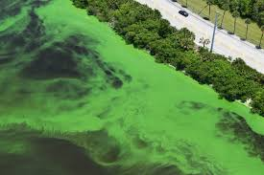
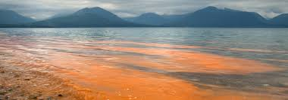
PROBLEM: HAM
Harmfull Algae Blooms causes:
- Thermal pollution - Agricultural waste

Slide 3
AIM
Find species that can thrive warm high nutrient condition
Investigate usefulness
Farm algae while cleaning water

Slide 4
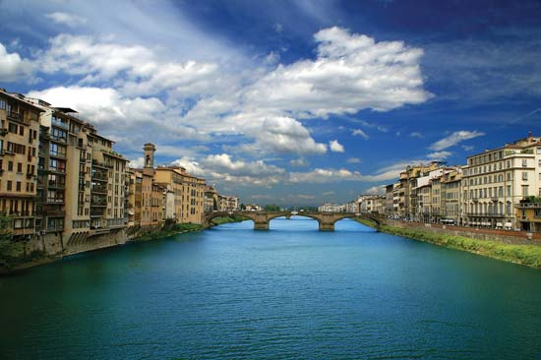
ENVIRONMENT
Italian Rivers
Po | Tevere | Adige
Isonzo | Piave | Arno
Reno | Garigliano | Livenza

Slide 5
METHOD
Two sample from delta\estuary of the river:
  Summer
  Winter
Metabarcoding analysis
  DATURA sampling kit
  DATURA commissioned analysis

Slide 6

ANALYSIS
Compare species present in each river
Find species common in multiple site
Select useful one
      - Farming
      - Cleaning River

Slide 7
COST
DATURA Kit \ sample : 350 euro
Vacuum Pump Rent : 200 euro
Rubber Dinghy : 150 euro
Miscellaneous : 659,3 euro remaining

Slide 8
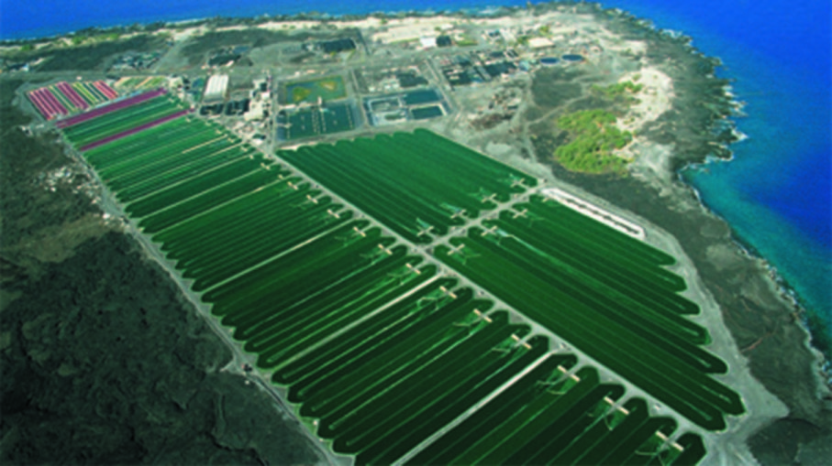
EXPECTED RESULTS
Species Common to various river
Species that can grow using the resources \ condition present in the rivers
Possibly farming suited algae

Slide 9
IMPACT
New Industrial Sector
Improving of Italian coasts
Cleaning of Rivers

Slide 10
REFERENCES
DATURA : http://datura.nl/
KIT : http://datura.nl/diensten/edna-monitoring-2/edna-bemonstering/

